Slide 1

Intellectual Risk Taking
Creativity
Inclusivity
Mindset
Reflection
Charlotte Annie, Professional Writing Consultant
University of Colorado Denver

Slide 2

Take Intellectual Risks
Explore new ideas without the fear of failure
Ask questions
Value inquiry, as well as knowledge
Collaborate with others
Take ownership of your learning
Persevere in the face of challenge

Slide 3
Encourage Intellectual Risk Taking
Foster an environment that supports independent thinking.
Provide low stakes opportunities where it’s OK to fail.
Ask open ended questions and do not advocate solutions.
Encourage peer-based learning.
Create an inclusive environment.

Slide 4
Foster an environment that supports independent thinking.
  Encourage consultants to act, rather than be acted upon, by asking them to do their thinking, talking, and naming for themselves.
  Ask that leadership have a clear, distinct role—allowing consultants to take ownership of their actions and decisions.
  Ask consultants to voice their opinions openly, as well as support and defend their conclusions.

Slide 5
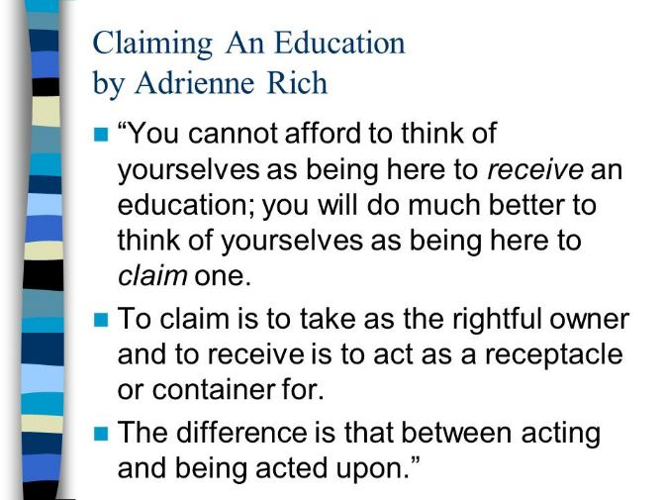
Foster an environment that supports independent thinking.

Slide 6
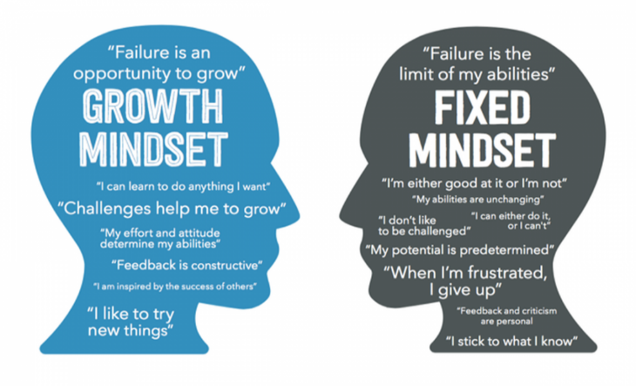
Provide low-stakes opportunities where it’s OK to fail.
    Teach consultants to have a growth mindset.
    Encourage them to fail often, and reflect on how they’ve learned from their mistakes.

Slide 7
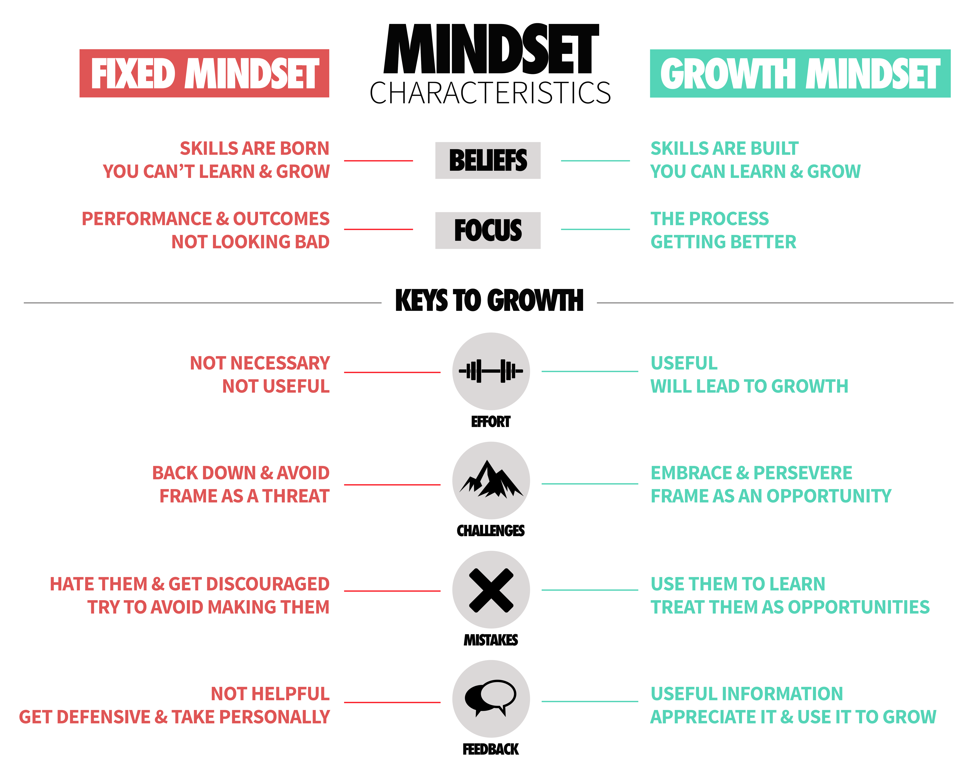
Provide low-stakes opportunities where it’s OK to fail.

Slide 8
Ask questions that are open ended and do not advocate solutions.
■ Include reflection exercises, which ask consultants to report on their experience working with students, or giving presentations.
■ Give consultants a chance to aid in the design, or help create and define aspects of certain activities/assignments.
■ Create a place for consultants to express their concerns openly without the fear of being punished or judged.

Slide 9
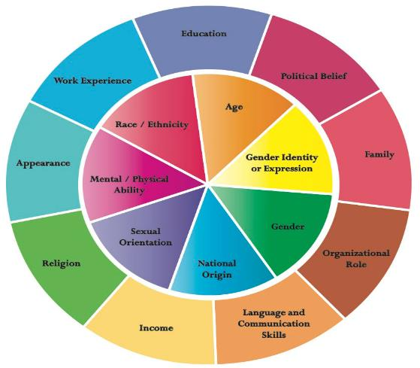
Encourage peer-based learning.
Have consultants engage in activities that build trust and facilitate learning, such as discussing personal identity factors and the role they play in student success.

Slide 10

Create an inclusive environment.
Include a diversity statement as well as a mission statement.
Provide comprehensive and ongoing consultant training (to include education about diversity and inclusion, as well as other pertinent social justice issues within the context of writing center pedagogy),
Implement gender-neutral pronouns.
Actively recruit minority consultants.

Slide 11
Create an inclusive environment.
■ Include a diversity statement as well as a mission statement.
As a part of the global community, the KU Writing Center fosters diversity in all of its dimensions and supports writers in reaching their personal and professional goals. All writers, with their unique life experiences, worldviews, languages and voices, are respected and welcomed. We provide an environment that is conducive to diverse learning styles and forms of expression, and we respect writers' use of their home languages and world Englishes. We also work with others to pursue justice and remedy current and historical inequities in higher education. Our Center embraces the humanity of all people, celebrating the contributions each individual makes to the Writing Center, KU, and the wider community.

Slide 12
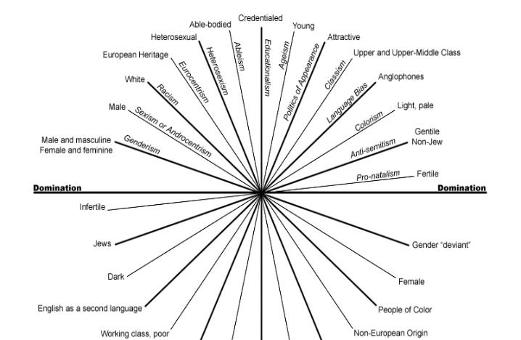
Create an inclusive environment.
■ Provide comprehensive training
Intersecting Axes of Privilege, Domination, and Oppression

Slide 13
Create an inclusive environment.
■ Implement gender-neutral pronouns.
Understand that one’s writerly and sexual identities are intertwined
Combat heterosexism and homophobia
Avoid issues of misidentification
  To maintain a sense of safety, LGBTQ+ individuals must constantly negotiate how they choose to perform their gender identity within differing social and cultural contexts. While lesbians or gay men may be able to “pass” within a predominately heterosexual environment or institutional setting, other who subvert gender norms, such as many transgender individuals, may not have the option.
  Giving pronoun options and displaying them for consulates might seem like a small gesture; however, avoiding issues of misidentification and is important for non-binary individuals, and it helps create a safer, more welcoming environment for our LGBTQ+ students.

Slide 14
Create an inclusive environment.
■ Actively recruit minority consultants.
Minority students need to feel included. They need to know that the writing center is a space where they are welcomed. Part of the way we can do this is through actively recruiting a diverse group of consultants. This means having tutors that are diverse in terms of race, class, disability, gender, sexuality, and language.
One way to do this is to become better connected with campus resources, such as the Women and Gender Studies Department, The Center for Sexuality and Diversity, and other groups who support minority groups on campus.

Slide 15

■ Consultants should be free to take creative and thoughtful risks. In fact, they should be encouraged to do so—to explore new ideas without the fear of failure.
■ Consider for a moment the potential impact this sort of positive risk-taking energy might have, not just on their lives, but the lives of others as well.
■ As they realize their own potential through risk, so too they will better understand how valuable risk can be in understanding, and making a difference in the world.

